Slide 1
Data Analyst Nanodegree
Session 3
Conducted by: Hamza
Notes:
https://udacity.zoom.us/j/7991233356

Slide 2
SUPPORT / REPOs
fwd-support@udacity.com
https://github.com/santarabantoosoo/Data-Analysis-NanoDegree-2.0

Slide 3

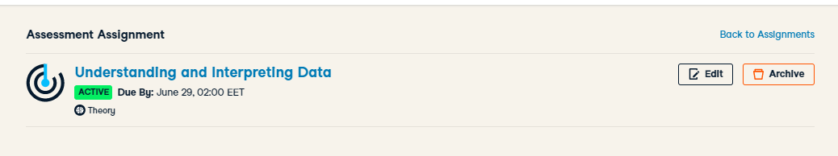
https://docs.google.com/spreadsheets/d/1VbURG9UQX4oaHhZeuHXW1FVdPLAUFhelfYK4f8N5z6c/edit#gid=0

Slide 4
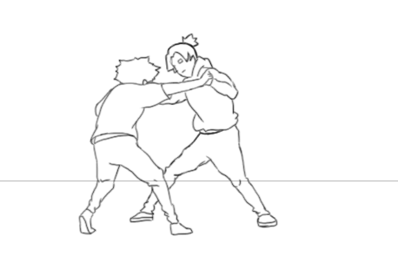
Competition

Slide 5

Compete within

Slide 6
Agenda
Descriptive stats … Lies?
Inferential stats .. Lies?
Probability
Distribution
Breakout room

Slide 7
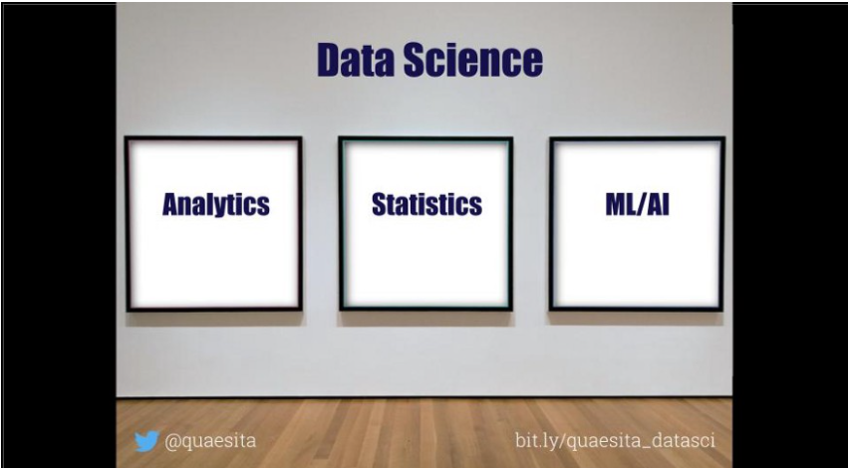
العركة؟
What’s the difference?

Slide 8



Analytics vs (statistics/AI/ML/DP)

Slide 9
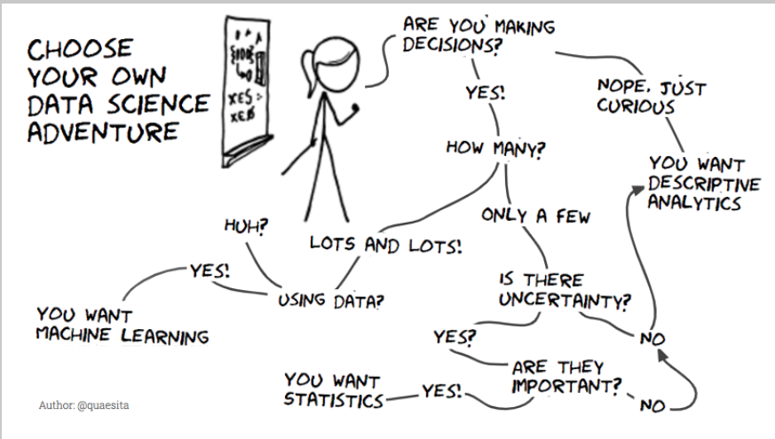

Slide 10
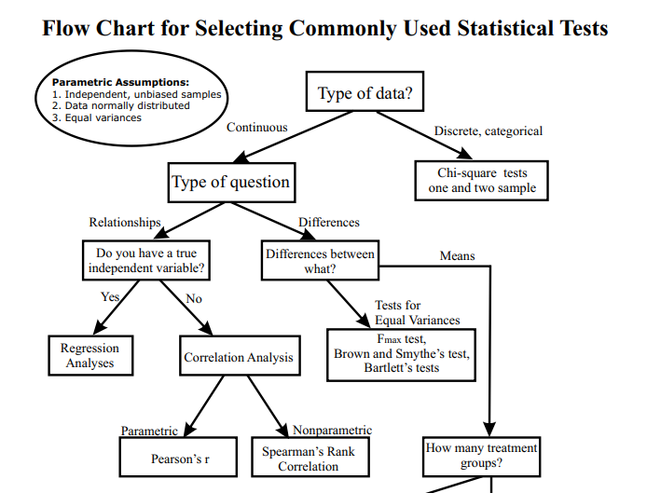
انت جاي تعمل ايه؟

Slide 11
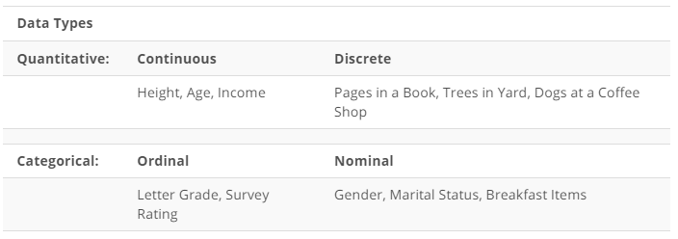

Slide 12
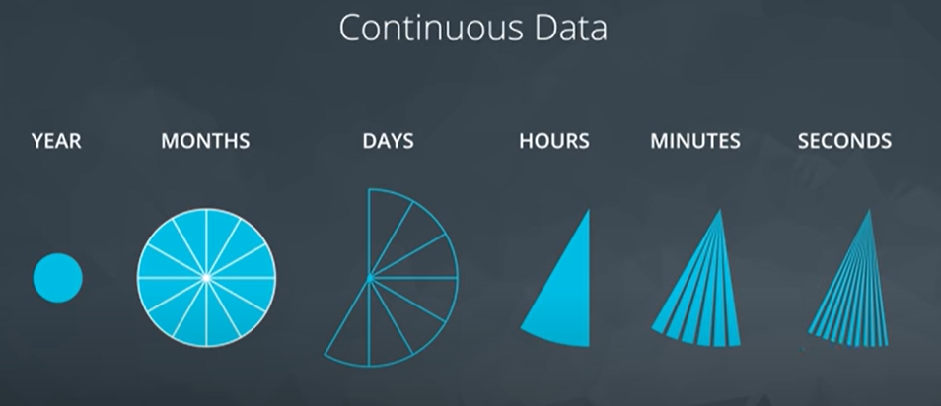
Notes:
What about discrete data?

Slide 13
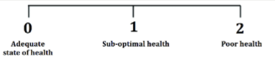
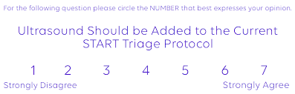
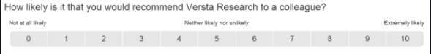
Data type
Notes:
Which can be converted to continuous ?
3 points … never
7 points … maybe
10 points .. Probably yes

Slide 14
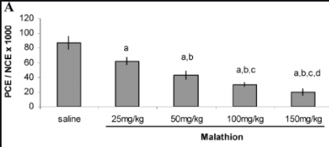
Data type
Notes:
Ordinal or nominal?
I think nominal..
But maybe if we changed saline to 0
Maybe it turns to be ordinal

Slide 15
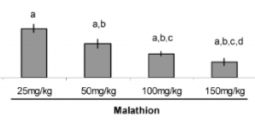
Data type
Notes:
Can be Nominal or ordinal

Slide 16
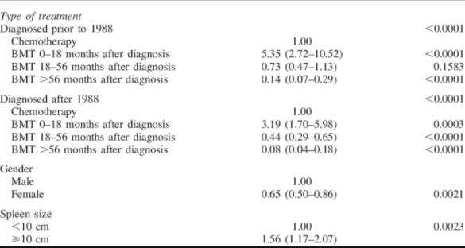
Bone marrow transplantation
Notes:
Spleen size> what’s the data type
Formerly : continuous
Then categorical
Time from bmt to diagnosis
Continuous then categorical maybe ordinal
Is it outcome variable … ordinal makes sense
Is it a predictor . Maybe order matters, like Cochrane Armitage

Slide 17
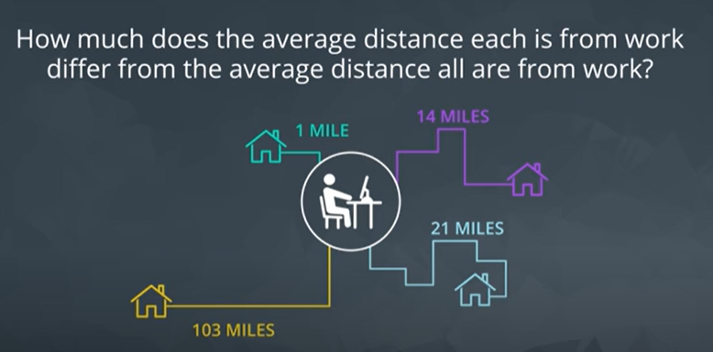
Standard deviation
Notes:
Standard deviation
Just a single estimate for the data spread

Slide 18
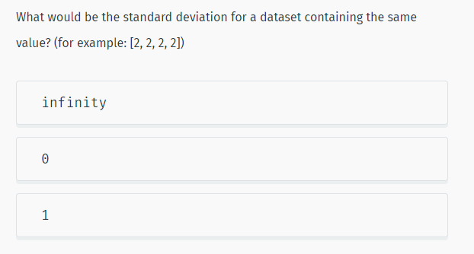
Notes:
More Statistics | SoloLearn
https://www.sololearn.com/learning/1161/4778/12271/2

Slide 19
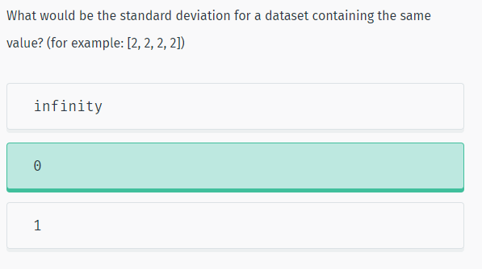
Solution

Slide 20
How to choose?
Range vs IQR
Mean vs median
Notes:
When to choose boxplot over histogram?
Normality : mean
Skewed : median /IQR / maybe range if no outliers
Outliers : IQR

Slide 21
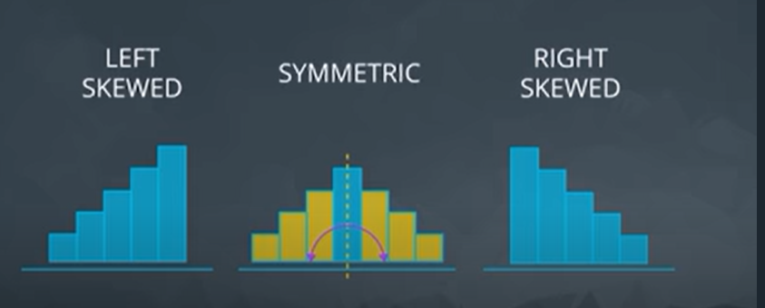
solution

Slide 22
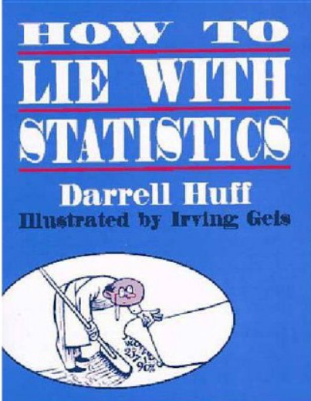
65 years old

Slide 23
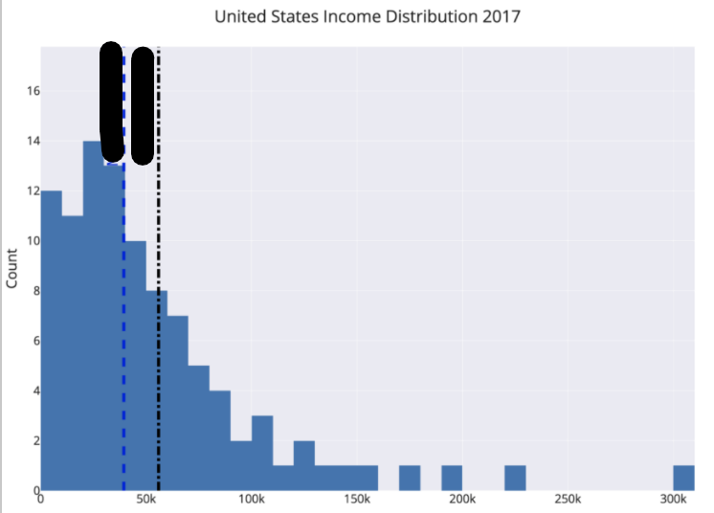
Where is the mean?

Slide 24
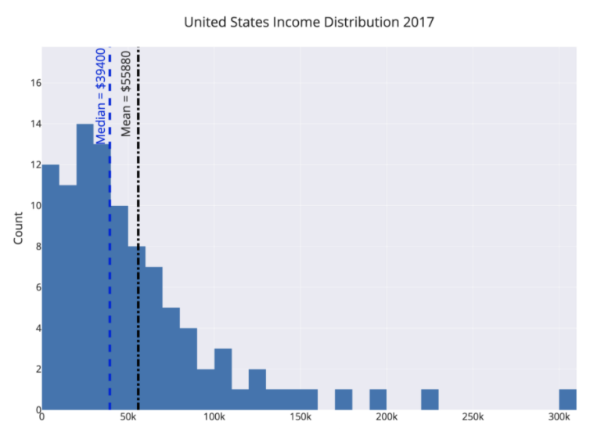
politicians, marketers,
and CEOs
Notes:
For example, the mean and median income in the United States differ by about $16,000. By choosing which value to report as the average, politicians, marketers, and CEOs can draw opposing conclusions from the same data.
How to avoid?
The way to avoid this is to look at the mean, median, and mode of a dataset (again you need all these numbers!). Figure out which one is most appropriate (usually the median for highly skewed datasets such as income, city size, life span, housing prices and so on) and use that if you need a one figure summary. If you can, graph the entire set of values in a histogram and look at the distribution. Try to use more than a single number to describe a dataset, and if you report an average, specify which you are using!

Slide 25
90% of Drivers Consider Themselves Above Average
What u think?
Notes:
wow, other people are terrible at evaluating themselves objectively.”
Although a headline like this is often used to illustrate the illusion of superiority, (where people overestimate their competence) it also provides a useful lesson in clarifying your assertions when you talk statistics about data. In this particular case, we need to differentiate between the mean and median of a set of values. Depending on the question we ask, it is possible for 9/10 drivers to be above average.
How 90% of Drivers Can be “Above Average” or Why You Need to be Careful When Using Statistics | by Will Koehrsen | Towards Data Science
https://towardsdatascience.com/how-90-of-drivers-can-be-above-average-or-why-you-need-to-be-careful-when-talking-statistics-3df7be5cb116

Slide 26
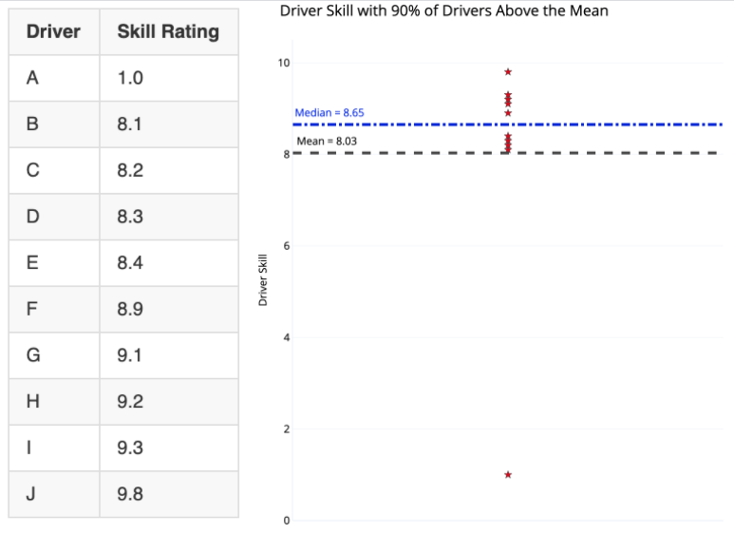
And now?
What do we call this point?
Notes:
The distinction is whether we use mean or median for “average” driver skill. Using the mean, we add up all the values and divide by the number of values, giving us 8.03 for this dataset. Since 9 of the 10 drivers have a skill rating greater than this, 90% of the drivers could be considered above average!
The median, in contrast, is found by ordering the values from lowest to highest and selecting the value where half the data points are smaller and half are larger. Here it’s 8.65 with 5 drivers below and 5 above. By definition, 50% of drivers are below the median and 50% exceed the median. If the question is “do you consider yourself better than 50% of other drivers?” than 90+% of drivers cannot truthfully answer in the affirmative.
outlier

Slide 27
Makes sense?
“Majority of people live longer than average”
Notes:
An example of a negatively skewed distribution is age at death. In this dataset, there are, unfortunately, some deaths at a relatively young age, lowering the mean and skewing the graph leftward (negatively).
In the case of a negative skew, the median is greater than the mean. The result is that more people can be above the “average” when the average is defined as mean. “Majority of people live longer than average” might be a strange headline, but if you choose your stats carefully, you can make it true.

Slide 28
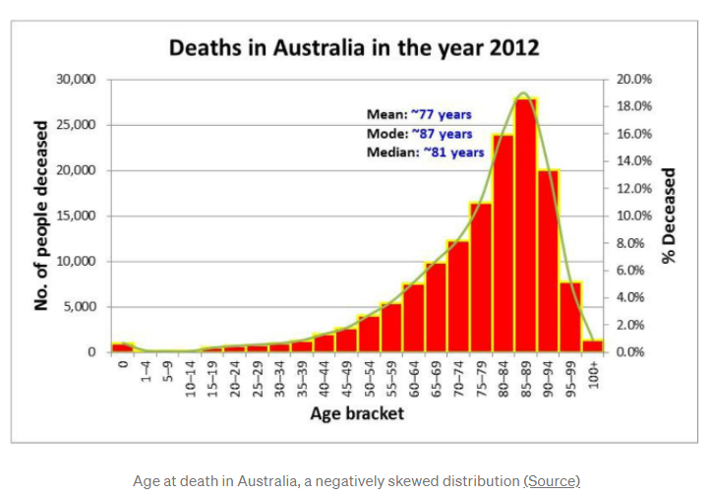
Makes sense?
“Majority of people live longer than average”
Notes:
An example of a negatively skewed distribution is age at death. In this dataset, there are, unfortunately, some deaths at a relatively young age, lowering the mean and skewing the graph leftward (negatively).
In the case of a negative skew, the median is greater than the mean. The result is that more people can be above the “average” when the average is defined as mean. “Majority of people live longer than average” might be a strange headline, but if you choose your stats carefully, you can make it true.

Slide 29
Conclusion?
When to use mean/median?

Slide 30


Two hospitals
100 child per day
10 child per day

Slide 31
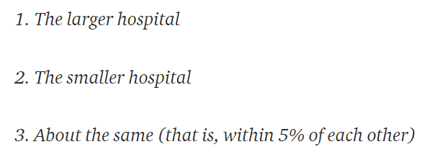
Hospital with more boys?
For 1 year, each hospital recorded no. of days where 60% of the babies born were boys.
- Which hospital do you think recorded more such days?
Notes:
A certain town is served by two hospitals. In the larger hospital, about 45 babies are born each day, and in the smaller hospital, about 15 babies are born each day. As you know, about 50% of all babies are boys. However, the exact percentage varies from day to day. Sometimes it may be higher than 50%, sometimes lower.
For a period of 1 year, each hospital recorded the days on which more than 60% of the babies born were boys. Which hospital do you think recorded more such days?
If you guessed 2., then congratulations, you are data literate! The reasoning is the smaller the sample size, the more extreme the values.

Slide 32

4 heads out of 5?
Notes:
You can test the principle that small samples produce extreme results by flipping a coin. With a small sample, say 5 tosses, there is a good chance you get 4 tails. Does this mean the coin always comes up 80% tails? No, this means your sample is too small to draw any significant conclusions.
This trick is often used when marketing products by asking a small number of people about a particular brand. You can get impressive-sounding numbers (90% of doctors like this toothpaste) if you repeatedly survey small groups and only report the favorable results. Ask a small group, look at the results, throw away the bad, and repeat until you get the stats you need!

Slide 33
Conclusion?
Small Samples Produce Shocking Statistics
Avoid fishing

Slide 34
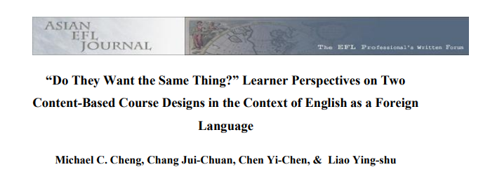
Academic papers?
“over70 percent of the students preferred language-skills courses over other courses”
“of the 41 percent who planned to seek employment, an overwhelming majority of respondents (82%)disliked the idea of content-driven design (Design 1)”
Notes:
In their study on learner perspectives in the context of English as a ForeignLanguage, Cheng, Jui-Chuan, Yi-Chen and Ying-shu (2010: 79) found that “over70 percent of the students preferred language-skills courses” over other courses, which seems quite a lot. They furthermore add that “of the 41 percent who plannedto seek employment, an overwhelming majority of respondents (82%)disliked theidea of content-driven design (Design 1)” (Cheng et al. 2010: 80). The reader hasto be very diligent here and go back to the methodology section where the authorsexplain that they included only 96 participants in their study, which is“approximately 35% of the target population” (Cheng et al. 2010: 75). Hence, from274 students, a number that was not directly stated, the authors were able to ask96, which means that 35% represent the target group. From these 96 students, 41%“plan to seek employment”. This makes 39 students. 82% of these 39 students,meaning 32 students, are described as “an overwhelming majority” who “dislikedthe idea of content-driven design” (Cheng et al. 2010: 80). In the end, however,the authors only refer to 32 out of274 students. “Overwhelming” does thereforedefinitely not seem fitting. This example shows that students should be aware thatthe reference sample might be quite small and not be of importance yet still beemphasised in several studies. It should not be confused with the larger overallsample.
(11) (PDF) Statistics Can Lie! – Using Descriptive Statistics in Academic Writing to Shape Reader’s Interpretations | Jessica Dheskali - Academia.edu
https://www.academia.edu/43624921/Statistics_Can_Lie_Using_Descriptive_Statistics_in_Academic_Writing_to_Shape_Reader_s_Interpretations

Slide 35
Back to methodology section
274 students
“over70 percent of the students preferred language-skills courses over other courses”
“of the 41 percent who planned to seek employment, an overwhelming majority of respondents (82%)disliked the idea of content-driven design (Design 1)”
96 participants
39 students
32 students
Notes:
In their study on learner perspectives in the context of English as a ForeignLanguage, Cheng, Jui-Chuan, Yi-Chen and Ying-shu (2010: 79) found that “over70 percent of the students preferred language-skills courses” over other courses, which seems quite a lot. They furthermore add that “of the 41 percent who plannedto seek employment, an overwhelming majority of respondents (82%)disliked theidea of content-driven design (Design 1)” (Cheng et al. 2010: 80). The reader hasto be very diligent here and go back to the methodology section where the authorsexplain that they included only 96 participants in their study, which is“approximately 35% of the target population” (Cheng et al. 2010: 75). Hence, from274 students, a number that was not directly stated, the authors were able to ask96, which means that 35% represent the target group. From these 96 students, 41%“plan to seek employment”. This makes 39 students. 82% of these 39 students,meaning 32 students, are described as “an overwhelming majority” who “dislikedthe idea of content-driven design” (Cheng et al. 2010: 80). In the end, however,the authors only refer to 32 out of274 students. “Overwhelming” does thereforedefinitely not seem fitting. This example shows that students should be aware thatthe reference sample might be quite small and not be of importance yet still beemphasised in several studies. It should not be confused with the larger overallsample.
(11) (PDF) Statistics Can Lie! – Using Descriptive Statistics in Academic Writing to Shape Reader’s Interpretations | Jessica Dheskali - Academia.edu
https://www.academia.edu/43624921/Statistics_Can_Lie_Using_Descriptive_Statistics_in_Academic_Writing_to_Shape_Reader_s_Interpretations

Slide 36
Conclusion?
Small numbers again
Beware of percentages!

Slide 37



Iq test
Notes:
two children, one of whom tests a 99 on IQ and the other a 102, you really should not tell them to avoid comparisons. Why? Because IQ tests can have a standard error of around 3 points which means a child scoring a 99 once would be expected to score between 96 and 102 about 68% of the time. The overall difference might not be significant and could reverse itself in repeated testing. In other words, by leaving out the expected standard error in the results, you can draw a more drastic conclusion than that offered by the data.

Slide 38
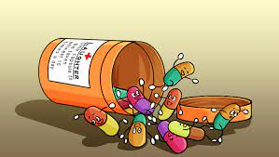
increased lifespan by 2 years on average
Notes:
Think of it this way: if there was a medicine that increased lifespan by 2 years on average would you take it? Would it change your mind if the worst impact was a loss of 12 years of life and the maximum a gain of 14 years? It usually is the details that matter and one summary statistic cannot tell the whole story.

Slide 39
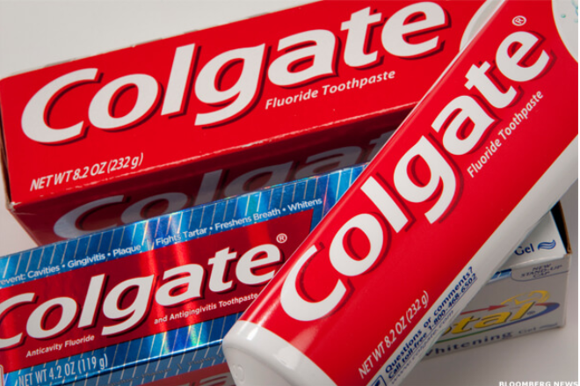
More than 80% of Dentists recommend Colgate
Notes:
Misleading Statistics & Data – News Examples For Misuse of Statistics
https://www.datapine.com/blog/misleading-statistics-and-data/

Slide 40
More than 80% of Dentists recommend Colgate
In 2007, Colgate was ordered by the
Advertising Standards Authority (ASA)
of the U.K. to abandon their claim
Why?

Slide 41
The question
Which toothpaste do u recommened? (more than 1 answer possible)
colgate
sensodyne
Miswak
…
Notes:
The claim, which was based on surveys of dentists and hygienists carried out by the manufacturer, was found to be misrepresentative as it allowed the participants to select one or more toothpaste brands. The ASA stated that the claim “… would be understood by readers to mean that 80 percent of dentists recommend Colgate over and above other brands, and the remaining 20 percent would recommend different brands.”

Slide 42

misleading
Come back ☺
Small numbers??
Notes:
The ASA continued, “Because we understood that another competitor’s brand was recommended almost as much as the Colgate brand by the dentists surveyed, we concluded that the claim misleadingly implied 80 percent of dentists recommend Colgate toothpaste in preference to all other brands.” The ASA also claimed that the scripts used for the survey informed the participants that the research was being performed by an independent research company, which was inherently false.
Maybe small numbers of surveys is also a similar problem
U survey 10 dentists. By chance u get very good results. U keep them
And remove other results that were unfavorable

Slide 43
Conclusion?
Multiple answer questions …. A totally different scenario!

Slide 44

☹ ☹
289 murders in 2018

Slide 45
Context ☺ ☺
289 murders in 2018
2245 murders in 1990
Notes:
You can scare people by saying New York had 289 murders in 2018, but when you compare that to 2245 in 1990, you realize New York City has never been safer! It’s usually the comparison that matters; don’t let an isolated number sway your rational thinking.

Slide 46

Unemployment
2019 20%
2020 13%

Slide 47

Changed definition
Notes:
The easiest way to lower unemployment is just to change the definition to exclude people who have stopped looking for work.

Slide 48
Conclusion?
Always have a reference
Check definitions and ensure their consistency

Slide 49
Don’t Place Too Much Faith in any One Statistic
“How to Lie with Statistics” ➔ view any single statistic with skepticism.
Any number represents a distillation of a set of data, which was taken on a sample of a population by mistake-prone humans, using imperfect tools, in constantly changing conditions at a single point in time.
Notes:
The overall theme of “How to Lie with Statistics” is: view any single statistic with skepticism.
Any number represents a distillation of a set of data, which was taken on a sample of a population by mistake-prone humans, using imperfect tools, in constantly changing conditions at a single point in time.

Slide 50
Enough?
The data was analyzed by another human, who works for an institution, which may have outside funders with differing motivations. Finally, the statistic or graph was delivered to you by a publisher that has its own interests in getting you to believe one idea.
Notes:
All this leads to two conclusions:
If you put all your faith in one number, then you will be overfitting to the particular circumstances that produced the number.
Statistics and data are never purely objective. A statistic is one interpretation of uncertain data designed to persuade.
We should look for the range of values, report numbers with confidence intervals, gather more data before jumping to conclusions, compare multiple studies, and ask about the design of the data-gathering process

Slide 51
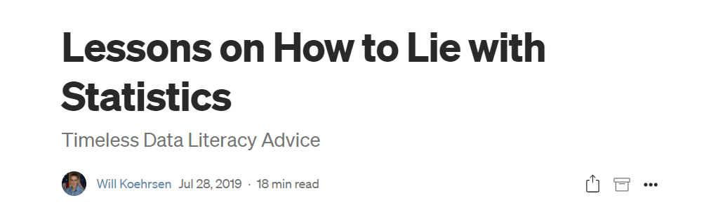
Want to learn more?
Notes:
Lessons on How to Lie with Statistics | by Will Koehrsen | Towards Data Science
https://towardsdatascience.com/lessons-from-how-to-lie-with-statistics-57060c0d2f19

Slide 52
Enough lies. Let’s work!
How to conduct descriptive statistics?
How to make ur life easier?

Slide 53
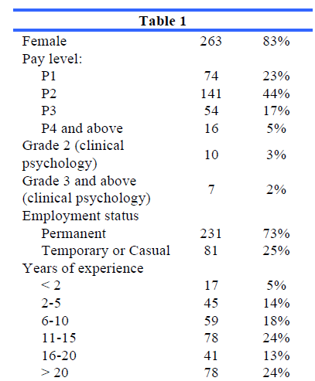
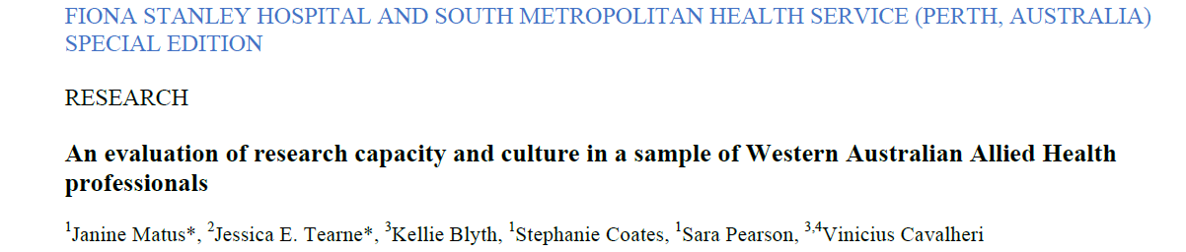
Real life

Slide 54
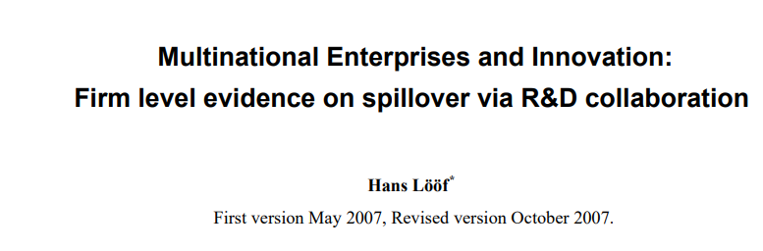
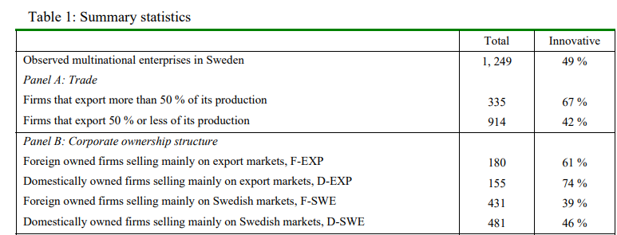
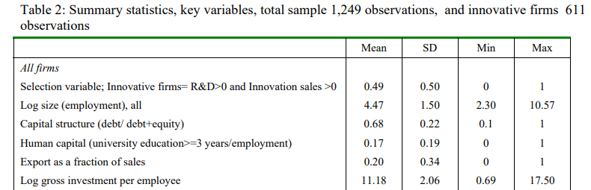
Different specialties

Slide 55
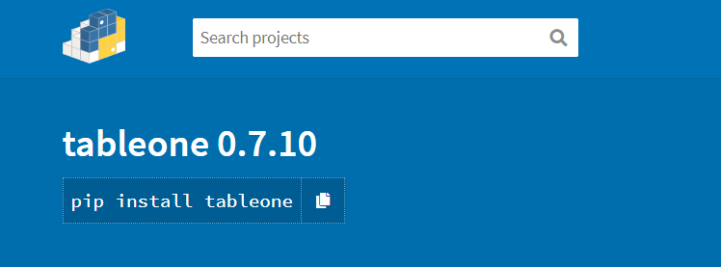
https://pypi.org/project/tableone/
Notes:
tableone · PyPI
https://pypi.org/project/tableone/

Slide 56
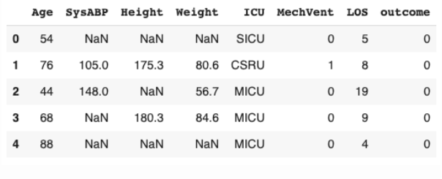
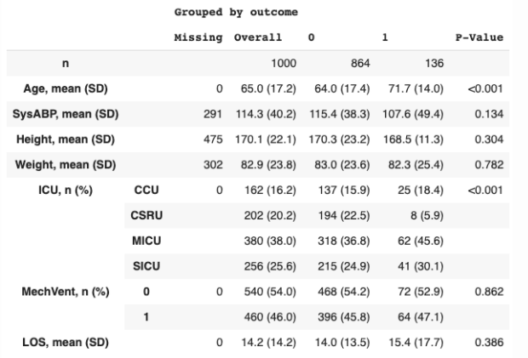

What happened?
Notes:
Continuous variables : mean SD
Categorical variables : frequency percentage
Grouped by outcome

Slide 57
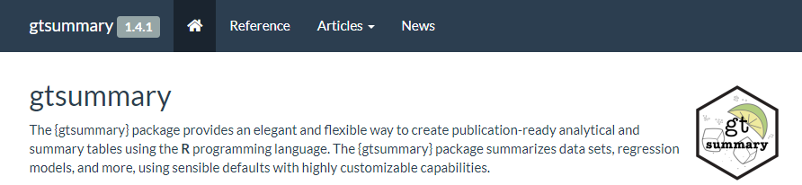
More flexibility?
http://www.danieldsjoberg.com/gtsummary/
Notes:
Presentation-Ready Data Summary and Analytic Result Tables • gtsummary
http://www.danieldsjoberg.com/gtsummary/

Slide 58
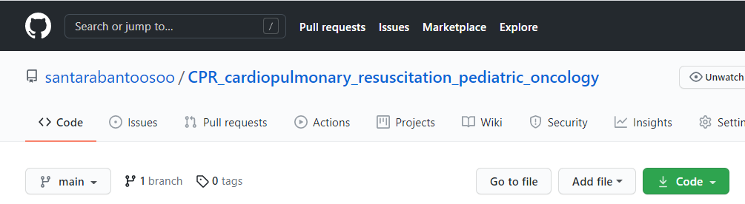

Slide 59
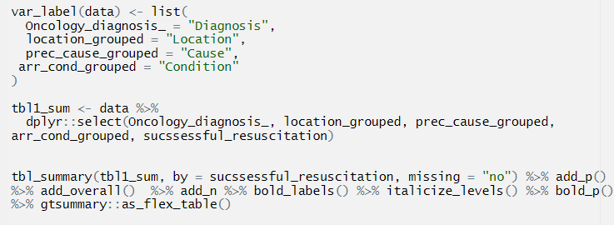
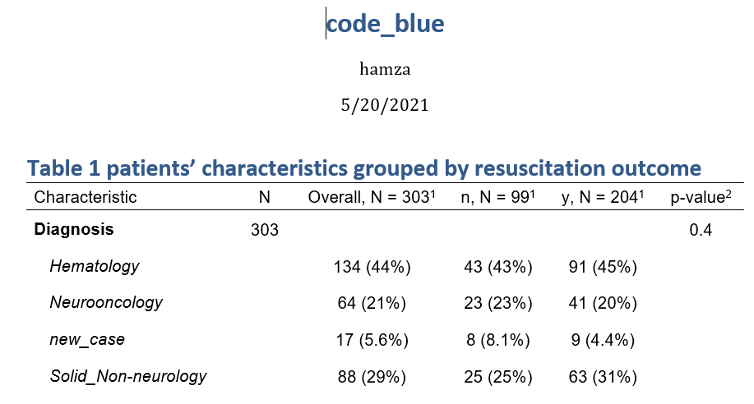
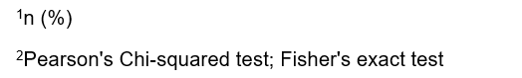

Slide 60
Inferential statistics

Slide 61

Conduct a study!

Slide 62
What u think?
“A statewide antibody study estimates that 21% of New York City residents have had the coronavirus, Cuomo says.”

Slide 63
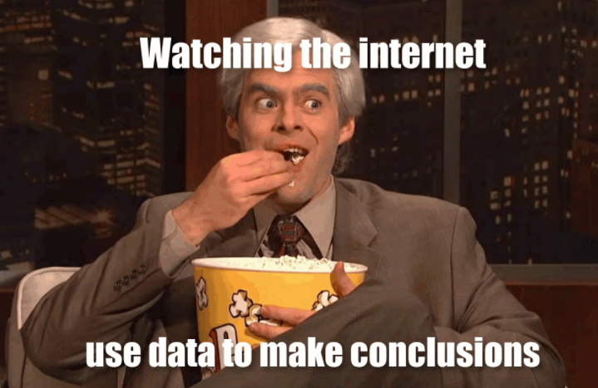
Trust ☺
Notes:
Ya3ny eh?
If lopsided results are misleading, that doesn’t necessarily mean that they were born out of the intent to mislead. Perhaps they were, perhaps they weren’t. Statistical bias can come about through negligence, ignorance, expediancy, or shenanigans.

Slide 64

What is bias?
What’s variance?

Slide 65
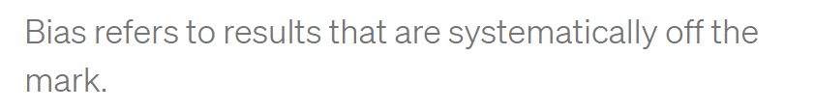
Notes:
High bias doesn’t mean you’re shooting all over the place (that’s high variance), but may cause a perfect archer hit below the bullseye all the time.

Slide 66
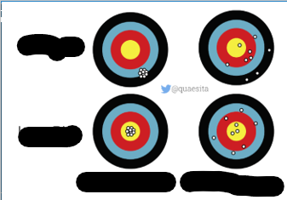

Slide 67
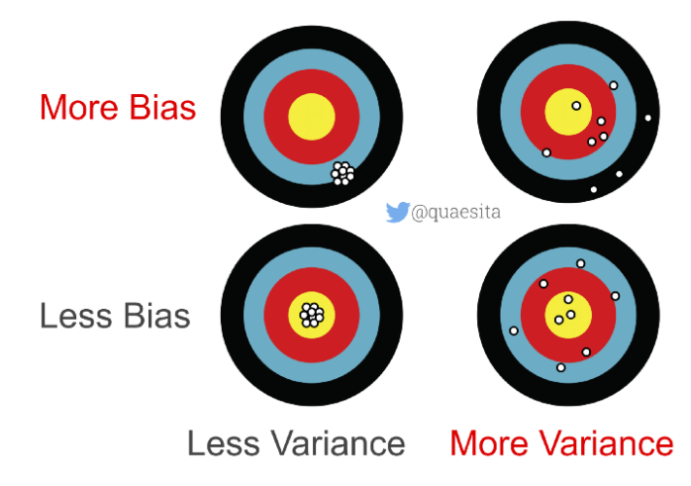

Slide 68
Bias/variance? Over or under?
“A statewide antibody study estimates that 21% of New York City residents have had the coronavirus, Cuomo says.”
What u think?
Notes:
Over or under estimation?
Over estimation
The true is low
Why? I smell the pungent odor of randomization issues with how the data were obtained, which brings me to statistical subdefinition #2.

Slide 69

Indoor?
Notes:
What clever thing did they do to collect data from people who stay indoors?
As it turns out, no clever thing.

Slide 70
Questions to ask?
What’s the probability the study measured someone who is fully self-quarantined?
How many NYC residents are keeping themselves entirely to themselves?
Notes:
Zero.
We don’t know.

Slide 71
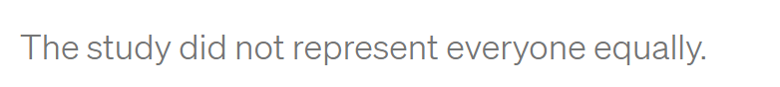
conclusion
Notes:
Selection bias
A special way to trigger results that are systematically off the mark is to collect your data in a problematic manner. For statisticians who love having things to be grumpy about, selection bias is a cherished frenemy. It visits so often!
Selection bias occurs when different members of your population of interest have different probabilities of arriving in your sample.
In other words, you’re making conclusions from your sample as if it were drawn randomly while it was drawn, er, “randomly” instead.

Slide 72

Notes:
In that case, your sample isn’t representative of your population… which makes your conclusions untrustworthy.
If your population of interest is all New York City residents, then you don’t have a random sample (SRS) unless every single New York City resident has equal probability of being included. Is that requirement met by the NY antibody study? Definitely not.

Slide 73
Undercoverage bias
How to solve?

Slide 74
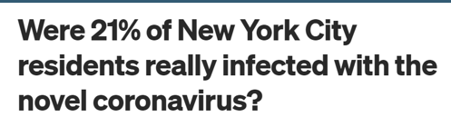
Solution
“all NYC residents who go outside”
Notes:
One pragmatic quick fix for undercoverage bias is to settle for a less ambitious population definition. Instead of trying to make inferences about “all NYC residents” you could choose instead to talk about “all NYC residents who go outside” — problem solved!

Slide 75
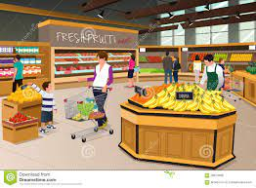
Now fixed?
The study tested people “at
grocery and big-box stores.”
Any problem?
Notes:
Let’s see how the data were gathered. The study tested people “at grocery and big-box stores.” If you’d like increase your probability of exposure, where do you go? To places with a higher density of people, like grocery and big-box stores. Where was the study done? Yup.

Slide 76
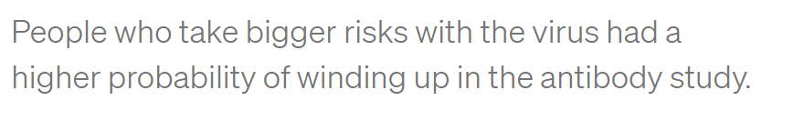
Grocery frequent visits
Notes:
How about if you really, really, really want to get the virus? You might go to grocery and big-box stores frequently… more frequently than someone who’s trying to reduce their probability of infection. Of these two kinds of people, which kind of person would be more likely to have COVID-19 antibodies? Which do you think would be more likely to be in the right place at the right time to participate in the study? Hello, selection bias!

Slide 77

volunteer bias ?
Notes:
volunteer bias because he suspects he was infected, or currently infected

Slide 78
How to solve?
Notes:
Biased archers have it easy — if you keep hitting the target above the center, at least you can see it and make adjustments. Researchers with selection bias aren’t so lucky. Selection bias means all your results are wrong and you don’t know how wrong.

Slide 79
No Solution ☹
Why?

Slide 80
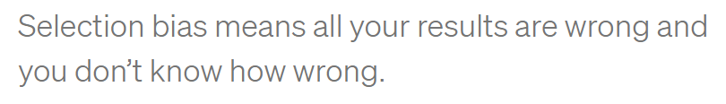
No Solution ☹

Slide 81

Notes:
Is this enough?

Slide 82
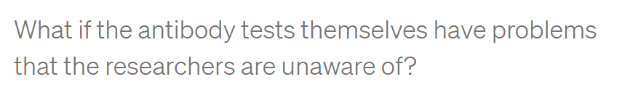
Biased conclusions
PCR sensitivity
threshold
Notes:
information bias occurs when measurements are systematically incorrect.
Have u heard of PCR sensitivity?
What if they only detect antibodies above a strict threshold to avoid false alarms?

Slide 83
Information vs selection
خالصين ؟

Slide 84
Conclusion about population?
What do we know about NYC residents’ actual exposure rate?
Notes:
Exposure rate : we know Nothing

Slide 85
Conclusion about population?
What do we know about NYC residents’ actual exposure rate?
- What do we know for sure?
Notes:
What we know for sure?
Some people at grocery and big box stores got an exciting readout from something called an antibody test.

Slide 86
Business Insider
“preliminary”
sampling issues
So where is the problem?
Notes:
To be fair to Business Insider, I think they did a pretty good job of reporting. They even called the results “preliminary” and mentioned some of the same sampling issues I talked about. Kudos! These are the same properly-cautious noises originally made by the governor of NY and the team who ran the study. I have no beef with them either. Instead, my complaint is with the broken telephone game that the rest of the internet is playing.

Slide 87


What is the problem?
Soret el telephone el 5arban
Notes:
Instead, my complaint is with the broken telephone game that the rest of the internet is playing.

Slide 88

Most common
1- Read all article?
2- say I haven’t read
3- report the title only?
Notes:
What most frequently occurs on whatsapp?
Report the title only.

Slide 89

Reporting bias

Slide 90
When reporting bias happens?
Journal club?
Twitter?
Trick
Feel better
Advertising a scientific article
Notes:
Make pithy summaries of complicated things (e.g. to squeeze everything into a 280 character tweet).
Prevent readers’ eyes from glazing over (e.g. journalists editorializing scientific publications).
Persuade someone through trickery (e.g. conveniently “forgetting” to mention studies that cast doubt on the arguments you’re hoping to make).
Feel better about their opinions (e.g. when they’re suffering from confirmation bias).

Slide 91
Is the study worthless?
Notes:
Does this mean that the study is worthless? No, but it’s only as good as the assumptions you’ll make about it. Since there’s very little that we know for sure from its data, the only way to make inferences beyond the facts is to bridge the gap with assumptions. That’s all statistics is. Assumptions, not magic.
Unfortunately, we’re not all equally qualified to make good assumptions that lead to useful conclusions. For example, while I am a statistician with plenty of real-world data collection experience, I’m not an expert in antibody tests, so you shouldn’t trust me to make wise assumptions about their accuracy. Excellent! I don’t trust me either, so I’ll end up learning nothing about the virus exposure rate of NYC. The study is worthless in my hands.

Slide 92

Is the study worthless?
As good as the assumptions
Notes:
Does this mean that the study is worthless? No, but it’s only as good as the assumptions you’ll make about it. Since there’s very little that we know for sure from its data, the only way to make inferences beyond the facts is to bridge the gap with assumptions. That’s all statistics is. Assumptions, not magic.
Unfortunately, we’re not all equally qualified to make good assumptions that lead to useful conclusions. For example, while I am a statistician with plenty of real-world data collection experience, I’m not an expert in antibody tests, so you shouldn’t trust me to make wise assumptions about their accuracy. Excellent! I don’t trust me either, so I’ll end up learning nothing about the virus exposure rate of NYC. The study is worthless in my hands.

Slide 93

Notes:
Were 21% of New York City residents really infected with the novel coronavirus? | by Cassie Kozyrkov | Towards Data Science
https://towardsdatascience.com/were-21-of-new-york-city-residents-really-infected-with-covid-19-aab6ebefda0

Slide 94


Slide 95

N = 30 friends
Notes:
If you haven’t thought about this one, take a moment to guess. Imagine the group has N=30 people in it. What are the chances two people get their cake on the same day?

Slide 96

Notes:
Or, if that’s daunting, just answer this: would you prefer to bet me $10 that there are birthday duplicates or $10 that there aren’t?

Slide 97
Basics
“I’m, like, a 1000% sure that, like, they’re going to be late”
Any problem?
Notes:
Yeah
Probability lives between 0 and 1
Or 0 and 100%

Slide 98
How many options?
2 options for a vegetarian dish OR 3 options for a meaty dish

Slide 99
How many options?
2 options for a vegetarian dish OR 3 options for a meaty dish
5
AND one of 2 desserts?

Slide 100
How many options?
2 options for a vegetarian dish OR 3 options for a meaty dish
5
AND one of 2 desserts?
10

Slide 101

How many options?
2 options for a vegetarian dish OR 3 options for a meaty dish
5
AND one of 2 desserts?
What’s the probability a randomly selected meal is veg-friendly?
10
NUMERATOR = 2 x 2 = 4; DENOMINATOR = 10.
ANSWER = 4/10 = 40%
Notes:
Go look up a proof if you like… or satisfy yourself with a quick example and move along: If I have 2 options for a vegetarian dish OR 3 options for a meaty dish, then how many meal options do I have? 2 + 3 = 5. What if I can choose a main course AND one of 2 desserts? How many different meals am I choosing from? 5 x 2 = 10. Try it out with concrete examples of dishes and write it all out if you don’t believe me.
What’s the probability a randomly selected meal is veg-friendly?
NUMERATOR = 2 x 2 = 4; DENOMINATOR = 10. ANSWER = 4/10 = 40%

Slide 102
Counting basics
probability of NOT getting a 6 on a dice?

Slide 103

Complement
probability of NOT getting a 6 on a dice?
1–1/6 = 5/6

Slide 104

Notes:
The difference between a combination and a permutation is that order matters with permutations but not with combinations. If you think about the image above for a moment, you’ll see why the number of possible options is bigger with permutations than with combinations (if you run the numbers on choosing 7 from 200, you’ll see that the answer on the left is a 13 digit number while on the right it’s a 17 digit number, and if you ogle the formula you’ll see that there’s an extra term in the combination’s denominator that removes the effect of ordering after selection, dumping all the pills into a single container and shaking it). Fun fact: your so-called “combination” bike lock is actually a permutation-with-replacement bike lock. (Technically, a *combination* lock that opens with 1008 should also open with 0810 because order doesn’t matter.)

Slide 105

Notes:
Introduction to Probability | 365 Data Science Online Course - YouTube
https://www.youtube.com/watch?v=soZRfdnkUQg&list=PLaFfQroTgZnxtnfht3BzBHVfxodX9AR9F&index=15

Slide 106
approaches to probability
Counting
Frequency-based
Notes:
Event-based (involves enumerating events and counting them)
Frequency-based (involves distributions symbolizing how things would shake out if we observed our phenomenon in infinite parallel universes)
Subjective (involves distributions symbolizing human belief in what’s likely, ideally as expressed in terms of bets… since putting your money where your mouth is reduces your tendency to spew nonsense)

Slide 107



counting
Notes:
The early chapters tend to start with the event-based approach to probability. That’s because it’s an easy playground to get some basics across and most humans probably (heh) already have an intuition for it. Examples: What are the chances your fair coin comes up tails? 1/2. What are the chances you roll a 6 on a six-sided die? 1/6. What’s happening here?

Slide 108
Counting stuff
How many different ways can I select 10 committee members from 100 candidates?”
OR
“How many different options can I choose from when setting a 4-digit PIN?”
Notes:
To work with event-based probability, you need to be able to enumerate events and count them. That’s why your textbook probably drags you through combinatorics till you’re thoroughly sick of it.

Slide 109
وفجأة ....
Where are the counting?
where are combinations?
where are permutations?

Slide 110


counting
Notes:
In the event-based world, all building block events are equally probable so as to lend themselves to basic arithmetic unmolested by layers of messy modifiers. It’s a world where all the coins are fair, all the dice are balanced, all the cards are unscuffed, and all the birthdays are equally likely.

Slide 111


Real life
“What’s the probability you need to wait
more than 10 minutes for the bus?”
Notes:
Consider this question: “What’s the probability you need to wait more than 10 minutes for the bus?” This is going to be tricky to count (in nanoseconds?) and a pain because counting events means you can’t work with time as a continuous thing. It gets worse if you have a bus driver who has some probability of stopping for a smoke break that’s dependent on how late the bus is already. How are you going to enumerate that? You’re not. Maybe counting events isn’t your friend here…

Slide 112
Real life
“What’s the probability you need to wait
more than 10 minutes for the bus?”
Is counting possible?
Notes:
Consider this question: “What’s the probability you need to wait more than 10 minutes for the bus?” This is going to be tricky to count (in nanoseconds?) and a pain because counting events means you can’t work with time as a continuous thing. It gets worse if you have a bus driver who has some probability of stopping for a smoke break that’s dependent on how late the bus is already. How are you going to enumerate that? You’re not. Maybe counting events isn’t your friend here…

Slide 113
approaches to probability
Counting
Frequency-based
Notes:
Event-based (involves enumerating events and counting them)
Frequency-based (involves distributions symbolizing how things would shake out if we observed our phenomenon in infinite parallel universes)
Subjective (involves distributions symbolizing human belief in what’s likely, ideally as expressed in terms of bets… since putting your money where your mouth is reduces your tendency to spew nonsense)

Slide 114

Counting vs distribution?

Slide 115
Counting !!
What’s the assumption?
Notes:
if we assume all 366 birthdays are equally likely*, we can stick with counting. Whew!

Slide 116
Counting !!
What’s the assumption?
all 366 birthdays are equally likely
Any objections?

Slide 117
assumptions
“All solutions are wrong, but whichever one fits the assumptions you’re willing to live with might be useful to you.”

Slide 118

Back to problem!

Slide 119
Birthday DENOMINATOR
How many birthday options do we have for one person?
How many birthday options do we have for N=30 people?

Slide 120
Birthday DENOMINATOR
How many birthday options do we have for one person? 366
How many birthday options do we have for N=30 people?
AND vs OR ?

Slide 121
Birthday DENOMINATOR
How many birthday options do we have for one person? 366
How many birthday options do we have for N=30 people?
AND vs OR ?
366 ➔ 1ST AND 366 ➔ 2ND AND 366 ➔ 3RD … AND 366 ➔ Nth person.

Slide 122
Birthday DENOMINATOR
How many birthday options do we have for one person? 366
How many birthday options do we have for N=30 people?
AND vs OR ?
366 ➔ 1ST AND 366 ➔ 2ND AND 366 ➔ 3RD … AND 366 ➔ Nth person.
366 ^ N

Slide 123
Birthday NUMERATOR
Any idea?

Slide 124
Birthday NUMERATOR
1st ➔ 1 Jan OR
2nd ➔ 1 Jan
OR OR
1st ➔ 9 Feb
2nd ➔ 9 Feb

Slide 125

THE TRICK!
Notes:
Instead of counting all the ways we can have people sharing birthdays, the trick is to rephrase the problem and count a much simpler thing: the opposite!
So what we need to find is the answer to this: “What’s the probability that there’s NOT any birthday sharing in the crowd?” In other words, what’s the probability all birthdays are unique?

Slide 126
NUMERATOR
Options available
1st ➔ 366
2nd ➔ ?

Slide 127
NUMERATOR
Options available
1st ➔ 366
2nd ➔ 365
3rd ➔ 364
AND vs OR
Notes:
The first person has 366 options for a birthday (greedy pig) AND the second person has only 365 because we force them to have a different birthday. If person 1 is born on Oct 8 and we’re forcing our room to have N unique birthdays in it, we turn all Oct 8 birthday folk away at the door. Each applicant for the room has fewer options by one.
AND
So it’s 366 options for person 1 AND 365 for person 2 AND 364 for person 3 … AND (367— N) for person N.

Slide 128

What we want?
= 0.3

Slide 129

What we want!
= 0.3

Slide 130

conclusion

Slide 131

Different N
Notes:
If you’re curious to know the actual numbers (50% happens at N = 23, 99% at N = 55)

Slide 132
IS THIS THE BEST SOLUTION?
Is counting applicable here?
What’s the assumption again?
Notes:
Why is counting such a big deal early on in your textbook and then suddenly it disappears, leaving everyone disgruntled? Turns out that it’s mostly a means to an end, since the assumption that all elementary events are equally likely is too amateurish for most pros to stomach… even for birthdays.

Slide 133
IS THIS THE BEST SOLUTION?
Is counting applicable here?
What’s the assumption again?
all 366 birthdays are equally likely
Is it valid?
Notes:
Why is counting such a big deal early on in your textbook and then suddenly it disappears, leaving everyone disgruntled? Turns out that it’s mostly a means to an end, since the assumption that all elementary events are equally likely is too amateurish for most pros to stomach… even for birthdays.

Slide 134

Life insurance data (480,040)
By day
Notes:
An Analysis of the Distribution of Birthdays in a Calendar Year
https://www.panix.com/~murphy/bday.html
it becomes relevant that due to the way hospitals work, where C-sections and induced labor are not generally scheduled on the weekend, more children are born on Mondays and Tuesdays than on weekends.

Slide 135

By month
So what?
Notes:
The months July - October show higher than expected births and March - May show the most significant decline in births.

Slide 136


Notes:
Using the birthday paradox to teach probability fundamentals | by Cassie Kozyrkov | Towards Data Science
https://towardsdatascience.com/using-the-birthday-paradox-to-teach-probability-fundamentals-c08bbcb351d1

Slide 137

End of counting
Notes:
Guess here u need distribution to account for the fact that they are not equiprobable
U need different values for p ,since p != p

Slide 138

Welcome to distribution

Slide 139

How to solve with combinatorics

Slide 140

Truth table?
Notes:
U need to use the truth table to calculate the probability
But this is not practical

Slide 141

Welcome to distributions

Slide 142

Binomial distribution

Slide 143


What’s a probability distribution?
pdf
pmf
Notes:
Normal
Binomial
Exponential
Gamma

Slide 144

Distribution
Notes:
Which is more popular?
U add money to the bucket
The higher the bucket, the most popular AKA probable

Slide 145


Drinks till vomit
Which chart type?
Notes:
Histogram
Histograms are one way (among many) of summarizing and displaying our sample data. Their blocks are taller for more popular values of the data.

Slide 146

Distribution
Notes:
A distribution is a way to express the probabilities of the entire set of values that X can take.

Slide 147

What can we deduce?
How is this related to distribution?
Probability mass
function
Notes:
Now we can clearly see that the two most common categories are 100–200 and 400–500

Slide 148

Welcome to distribution
Notes:
Horizontal axis: population data values. Vertical axis: relative popularity.
As I’ve explained in detail here, a distribution is essentially an imaginary idealized bar chart (for discrete R.V.s) or histogram (for continuous R.V.s).* In other words, the distribution is taller for more likely values of X. The distribution for a fair die has equal height for all outcomes (“discrete uniform”); not so for a weighted die.
Here is the “understanding data” article

Slide 149

More info?
Notes:
Understanding data. Musings on information, memory… | by Cassie Kozyrkov | Towards Data Science
https://towardsdatascience.com/what-is-data-8f94ae3a56b4

Slide 150

Theme

Slide 151


Slide 152


Slide 153


Slide 154

Name of graph?
Describe the graph
in plain terms
Notes:
Histogram

Slide 155

Pick at random?
Notes:
Most probablt Between 5 and 6

Slide 156
Smaller bin size?
Notes:
Between 5 and 6

Slide 157

More precise?
Describe data
Notes:
Majority are between 5.25 nad 5.75

Slide 158

Even smaller?
Notes:
More accurate and more precise

Slide 159

approximation
Why is that useful?
Notes:
We can use a curve to approximate the histogram

Slide 160

No benefit yet
Any thing useful?
Notes:
Low prob at tails
And high probability at the peak

Slide 161


solution
Notes:
No bins can accommodate this

Slide 162

Notes:
More precise calculate using calculus or a computer

Slide 163

Notes:
StatQuest: What is a statistical distribution? - YouTube
https://www.youtube.com/watch?v=oI3hZJqXJuc

Slide 164
How to choose?
Why to choose?
Notes:
Normal
Binomial
Exponential
Gamma
Pdf
Pmf

Slide 165

Pause a minute

Slide 166

Pause a minute

Slide 167
Is the study worthless?
As good as the assumptions
Notes:
Does this mean that the study is worthless? No, but it’s only as good as the assumptions you’ll make about it. Since there’s very little that we know for sure from its data, the only way to make inferences beyond the facts is to bridge the gap with assumptions. That’s all statistics is. Assumptions, not magic.
Unfortunately, we’re not all equally qualified to make good assumptions that lead to useful conclusions. For example, while I am a statistician with plenty of real-world data collection experience, I’m not an expert in antibody tests, so you shouldn’t trust me to make wise assumptions about their accuracy. Excellent! I don’t trust me either, so I’ll end up learning nothing about the virus exposure rate of NYC. The study is worthless in my hands.

Slide 168
How to choose?
Why to choose?
Notes:
Normal
Binomial
Exponential
Gamma
Pdf
Pmf

Slide 169

لولو من أبولو

Slide 170

It differs
Notes:
List of Probability Distributions - Stat Mania English
http://en.statmania.info/2015/08/list-of-probability-distribution.html

Slide 171
Choosing Your Distribution
1- assume a distribution
2- other solutions (to be continued …)
Notes:
They either (1) estimate empirical distributions from their data — using, you guessed it, histograms! — or they (2) make theoretical assumptions about which member of a popular distribution catalog looks most similar to how they believe their data source behaves.
3) Kernel density without assumptions
MLE or method of moment
Or kernel density estimation
Or use bootstrap
I need to read Tom’s lectures

Slide 172

Which distribution?

Slide 173

Popular distributions
Notes:
On the plus side, named distributions come with neat PDFs and a bunch of calculations pre-done for you.
On the minus side, your application might not fit anything in a catalog. Thanks for the empirical option.
For the empirical, I think it may be hard to generalize.
Many items, ex. Bin size can make results unpredictable
Check the medium article

Slide 174



Why do I need a distribution?
Notes:
Imagine u r in an algebra exam.
U have a formula sheet
W see the questions and u want to answer ..
What to do?
Check the questions and see which one of them fits in ur sheet
Then answer
Or u can invent or derive a formula
Which needs time, validation, etc..

Slide 175

Why wait?
Notes:
If we have our data, and we have assumed a popular distribution. Why not start plotting?
Let’s be honest — the insights aren’t exactly leaping off the page. That’s why we tend to prefer asking questions about specific parameters of interest to us. In statistics, parameters summarize populations or distributions. For example, if you’re asking whether the distribution peaks at zero, you’re asking about the location of its mode (a parameter). If you’re asking how fat the distribution is, you’re asking about its variance (another parameter). In a moment, I’ll take you on a tour of a few of my favorite parameters.

Slide 176

Without parameters ☺
Notes:
If you look at the function above, you’ll notice that there are some Greek letters in there: μ and 𝜎.*** These are special parameters for this distribution; until we replace them with numbers, we’re not ready to plot anything. Without them, all we can do is get a vague sense of the abstract shape of the distribution, like so:

Slide 177
لولو من أبولو
Notes:
Aren’t all of these are normal distributions?

Slide 178

Normal distribution
http://shiny.calpoly.sh/Prob_View/
Notes:
There’s plenty more Greek to enjoy, since other distributions use other characters for their special quantities.

Slide 179
Pause a minute

Slide 180

More info?
This is part 1
Notes:
Getting to know probability distributions | by Cassie Kozyrkov | Mar, 2021 | Towards Data Science
https://towardsdatascience.com/getting-to-know-probability-distributions-cc1dd1e2f22b

Slide 181
Theme

Slide 182
Breakout room
Kaggle

